Slide 1
Home Depot Product Search Relevance
Srivarsini Rangarajan
Chaitanya Krishna Sai Kosaraju
Sai Kolanupaka Meghana Bharadwaj

Slide 2
Online Shopping
Great product at a great price
Convenience
Fewer traps
Compulsive shopping
Discreet shopping
Crowds
Variety

Slide 3
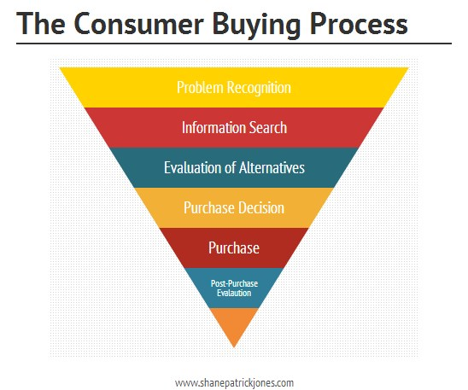

Slide 4


Information Retrieval

Slide 5
Identification of the Problem and Opportunity
What is the problem you are solving?
Prediction of relevance score for the given combination of search terms and products
What are the benefits to solving this problem?
The relevance parameter enhances the search results.
Better Marketing for the organization.
Improving the customer’s shopping experience.
If you solve it, why is it important?
Its presence would help eliminate/ reduce human intervention in programming/ updating & maintaining the search engine.
It enhances the value of a product.
The vast amounts of data observed can be synthesized to seize and predict customer behavior patterns for further analysis.

Slide 6
Importance of this Problem
Why is it important to solve this problem?
Without the use of information retrieval and ranking, the accuracy and efficiency for a match would be erroneous.
What are you’re a priori hypotheses?
To maximize the relevancy score prediction by reducing the Root Mean Square Error in our prediction model
Who cares about it?
Industries involved – From Retail to travel
If you were selling, who would buy your solution?
Kaggle and Home Depot

Slide 7
Prior Work
What has been done in the past to solve this problem?
Nearest centroid classifier
Google - PageRank, Hilltop Algorithm, Topic-Sensitive PageRank
Text Scoring
Amazon – A9
What has worked, what has not worked?
Information retrieval is striving to find the best fit but as the data grows the algorithm also need to be evolved.
Every search algorithm has its own advantages and disadvantages
What did you like/dislike?
Text Scoring approach is the one that we liked and we started our analysis upon that
What do you plan to leverage?
Take advantage of the existing tools like Python Machine Learning packages and other mining tools

Slide 8
Technical Approach
What are the analytical steps you are going to use to build your result?
Classification and Supervised Learning
Pruning the data set – Python Stemming
Implement the search algorithm – TF-IDF
Create the frequency set for the terms –Python
Determine the relevancy factor
Result Visualization
Prediction using regression
What are the questions you will answer?
Performance of the algorithm in terms of
Cross Validation Value
Root Mean Square Error
Execution time

Slide 9
Data
Files
train.csv
The training set, contains products, searches, and relevance scores.
test.csv
The test set, contains products and searches.
product_descriptions.csv
Contains a text description of each product.
attributes.csv
Provides extended information about a subset of the products (typically representing detailed technical specifications).

Slide 10
Snapshot of dataset Train Data
id | product_uid | product_title | search_term | relevance
2 | 100001 | Simpson Strong-Tie 12-Gauge Angle | angle bracket | 3
3 | 100001 | Simpson Strong-Tie 12-Gauge Angle | l bracket | 2.5
9 | 100002 | BEHR Premium Textured DeckOver 1-gal. #SC-141 Tugboat Wood and Concrete Coating | deck over | 3
16 | 100005 | Delta Vero 1-Handle Shower Only Faucet Trim Kit in Chrome (Valve Not Included) | rain shower head | 2.33
17 | 100005 | Delta Vero 1-Handle Shower Only Faucet Trim Kit in Chrome (Valve Not Included) | shower only faucet | 2.67

Slide 11
Product Description
product_uid | product_description
100001 | Not only do angles make joints stronger, they also provide more consistent, straight corners. Simpson Strong-Tie offers a wide variety of angles in various sizes and thicknesses to handle light-duty jobs or projects where a structural connection is needed. Some can be bent (skewed) to match the project. For outdoor projects or those where moisture is present, use our ZMAX zinc-coated connectors, which provide extra resistance against corrosion (look for a "Z" at the end of the model number).Versatile connector for various 90 connections and home repair projectsStronger than angled nailing or screw fastening aloneHelp ensure joints are consistently straight and strongDimensions: 3 in. x 3 in. x 1-1/2 in.Made from 12-Gauge steelGalvanized for extra corrosion resistanceInstall with 10d common nails or #9 x 1-1/2 in. Strong-Drive SD screws
100002 | BEHR Premium Textured DECKOVER is an innovative solid color coating. It will bring your old, weathered wood or concrete back to life. The advanced 100% acrylic resin formula creates a durable coating for your tired and worn out deck, rejuvenating to a whole new look. For the best results, be sure to properly prepare the surface using other applicable BEHR products displayed above. California residents: see&nbsp;Proposition 65 informationRevives wood and composite decks, railings, porches and boat docks, also great for concrete pool decks, patios and sidewalks100% acrylic solid color coatingResists cracking and peeling and conceals splinters and cracks up to 1/4 in.Provides a durable, mildew resistant finishCovers up to 75 sq. ft. in 2 coats per gallonCreates a textured, slip-resistant finishFor best results, prepare with the appropriate BEHR product for your wood or concrete surfaceActual paint colors may vary from on-screen and printer representationsColors available to be tinted in most storesOnline Price includes Paint Care fee in the following states: CA, CO, CT, ME, MN, OR, RI, VT

Slide 12
Attributes
Product_id | Name | Value
100001 | Product Height (in.) | 3
100001 | Product Weight (lb.) | 0.26
100001 | Product Width (in.) | 3
100002 | Application Method | Brush, Roller,Spray
100002 | Assembled Depth (in.) | 6.63 in
100002 | Assembled Height (in.) | 7.76 in

Slide 13
Test Data
id | product_uid | product_title | search_term | relevance
1 | 100001 | Simpson Strong-Tie 12-Gauge Angle | 90 degree bracket | ?
4 | 100001 | Simpson Strong-Tie 12-Gauge Angle | metal l brackets | ?
5 | 100001 | Simpson Strong-Tie 12-Gauge Angle | simpson sku able | ?
6 | 100001 | Simpson Strong-Tie 12-Gauge Angle | simpson strong ties | ?
7 | 100001 | Simpson Strong-Tie 12-Gauge Angle | simpson strong tie hcc668 | ?
8 | 100001 | Simpson Strong-Tie 12-Gauge Angle | wood connectors | ?
10 | 100003 | STERLING Ensemble 33-1/4 in. x 60 in. x 75-1/4 in. Bath and Shower Kit with Right-Hand Drain in White | bath and shower kit | ?
11 | 100003 | STERLING Ensemble 33-1/4 in. x 60 in. x 75-1/4 in. Bath and Shower Kit with Right-Hand Drain in White | bath drain kit | ?

Slide 14
Metrics
What will you measure during your analysis?
Prediction accuracy of different algorithms
How will you know when your are successful?
Cross Validation Score : 0 to 1
0 being the best and 1 being the worst
Root Mean Square Error
0 being the best and 1 being the worst
Execution time in seconds
Lower the better

Slide 15
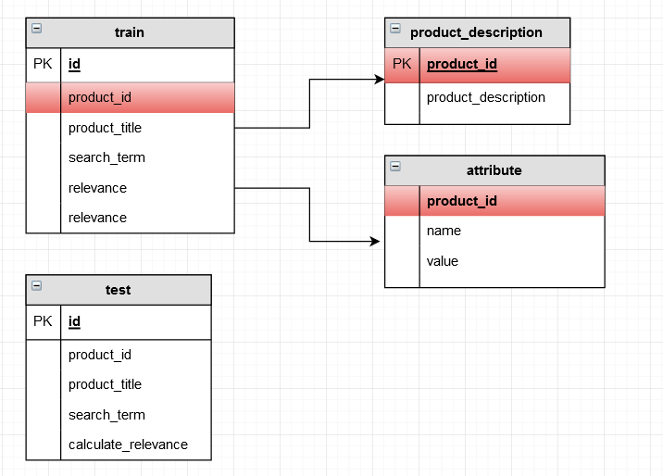
Entity Relation

Slide 16
Algorithms used
TF-IDF
Support Vector Machine
Decision Tree

Slide 17
TF-IDF
Why TF-IDF?
Text search
Large text in the product description field
Familiar
Consideration
Calculating the relevance based on product description and product title alone
Each word in search term as the word of interest and each record is considered as a document
Approach
Stemming of product description data
Generated a frequency table for product description
Create a dictionary containing search term for each search id
Iterate over the frequency table to calculate the term frequency and Inverse document frequency

Slide 18
Challenges Faced…
Generating the frequency for the huge dataset
Once after creating the frequency table we were unable to interpret the algorithm for our data
Solution:
Theoretical implementation of algorithm by taking a product and
calculating the relevancy using the frequency table that we generated
earlier to get an idea of how our results will look

Slide 19
Manual Example
product prod_id = 1
Search_id – 6(train) + 2(test)
Search query – angle bracket
Angle + bracket
For each term in search query
Find tf-idf in product title
Find tf-idf in product description
Finding tf-idf in product title
tf = count(angle) in record 1/total number of words in record 1
Idf = log[ count(total_records)/1+No. of records containing angle]
After calculating it we got the relevance score of about 0.9 which is very low compared to the given relevancy score of 3.

Slide 20


Slide 21
Support Vector Machine
Why SVC?
Supervised learning algorithm
Uses class labels and can be used for regression analysis as well
Supported by sklearn in python
Consideration:
Executed only in a subset of around 1000 products
Approach
Merge the all the available data into one data frame
Try to figure out the search term frequency count in different labels such as title, description and attribute
5 numeric vectors – 4 frequency vector and 1 predictor
Applied svm on training data and test data for 1000 products

Slide 22
Implemented SVM algorithm
Import all the data into data frame
Merge the data
Eliminate all the missing values
Combine the training and test data into one single frame
Attach the product description column to it based on product id
Apply stemming on all the columns containing string values – search_term, prod_title, prod_desc, prod_attr
Find the length of the query
Find term in title, description and attribute and count the frequency
Merge the frequency columns to the existing data frame
Create a data frame containing only the numeric labels – search-id, length of query, prod-id, term_description, term_attr, relevancy

Slide 23


Slide 24
Merged Data Frame
Search ID | Product ID | Relevancy | Query Length | Term Count Title | Term Count Description | Term Count Attribute
600 | 100095 | 3 | 3 | 3 | 3 | 2
605 | 100096 | 2 | 4 | 1 | 2 | 2
606 | 100096 | 2.67 | 3 | 1 | 1 | 1
611 | 100096 | 2.67 | 2 | 1 | 2 | 1
619 | 100097 | 2.33 | 6 | 4 | 5 | 4
626 | 100098 | 1.33 | 5 | 3 | 3 | 3
630 | 100100 | 3 | 2 | 2 | 2 | 2
1 | 100001 | ? | 3 | 0 | 1 | 1
4 | 100001 | ? | 3 | 1 | 1 | 1
5 | 100001 | ? | 3 | 1 | 1 | 1
6 | 100001 | ? | 3 | 2 | 2 | 2
7 | 100001 | ? | 4 | 2 | 2 | 2

Slide 25
Algorithm continued…
Using svm fit the relevance values based on the vectors search id, length of query, prod-id, term-title, term_description, term_attr
Use the classifier to predict the relevancy score in the test dataset

Slide 26
Output
Cross Validation Value – 0.7
RMSE – 0.5771
Execution Time – 31.622 seconds
Graph

Slide 27
Decision Tree
Why Decision Tree?
Supervised learning algorithm
Familiar
Easy to interpret
It will work on our numeric vectors that we created for SVM
Approach
Apply decision tree classification using sklearn on the numeric vectors

Slide 28
Output
Cross Validation Value – 0.7
RMSE – 0.8488
Execution Time – 25.80 seconds
Graph:

Slide 29
Comparison of algorithms

Slide 30
Conclusions
We found the SVM gives us better prediction than Decision tree
Consideration of the entire data set may change the result
Results could be improved by using features, brands, functionality of products while doing the classification
Ensemble technique would bring even higher prediction accuracy.
Relevancy Score generated will help the Home Depot Product Search team to maximize the customer satisfaction.

Slide 31
Questions and Suggestions…

Slide 32
Thank you!

